Slide 1
CWMUs with Public Land

Slide 2
Exceptions for public land to be in CWMU
(4) A CWMU may include public land only if:
(a) the public land is surrounded by private land or is otherwise publicly inaccessible;
(b) the public land is necessary to establish an enforceable and identifiable hunt boundary; or
(c) inclusion of the public land is necessary to achieve statewide and unit management objectives.

Slide 3
2024 renewals – Not accessible
CWMU | Species | Private Acres | Public Acres
Raft River | Deer | 5,380 | 1,240
Oak Ranch | Deer | 4,980 | 120
Scofield Canyons | Deer, elk | 12,310 | 40
Indian Creek | Deer | 7,342 | 30
Mt Carmel | Deer | 14,882 | 460

Slide 4
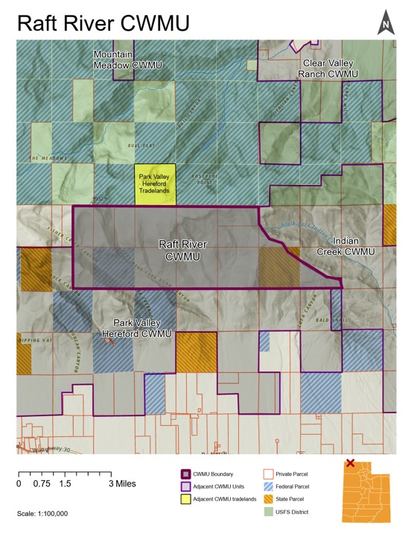
Raft River
Public land is not accessible except to other CWMUs
They have 1,240 public acres
They have 5,623 private acres
Public benefit – extra tags for the public using permit calculator 7:3

Slide 5
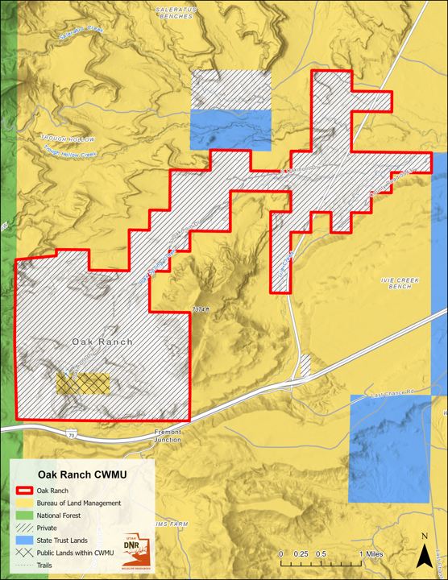
Oak Ranch
Public land is not accessible
They have 120 public acres
They have 4,980 private acres
Public benefit – extra permits 16:3

Slide 6
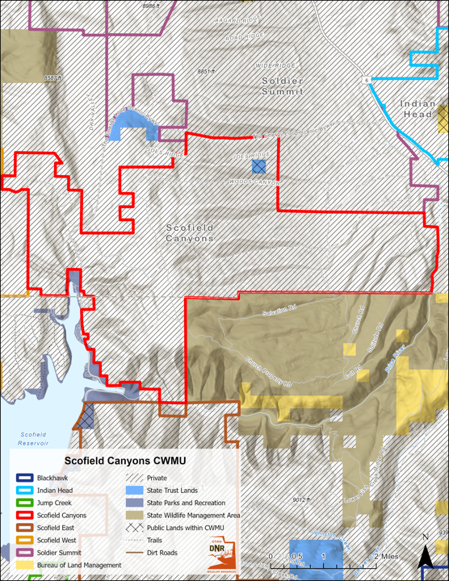
Scofield Canyons
Public land is not accessible
They have 40 public acres
They have 12,310 private acres
Public benefit – Public draw can hunt it

Slide 7
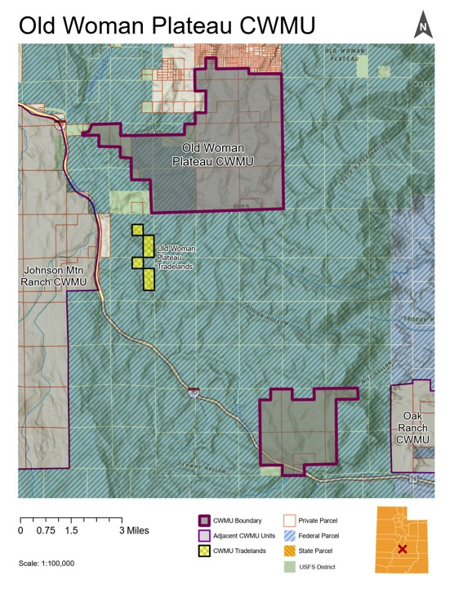
Indian Creek
Public land is not accessible
They have 30 public acres
They have 6,938 private acres
Public benefit – public draw can hunt it

Slide 8
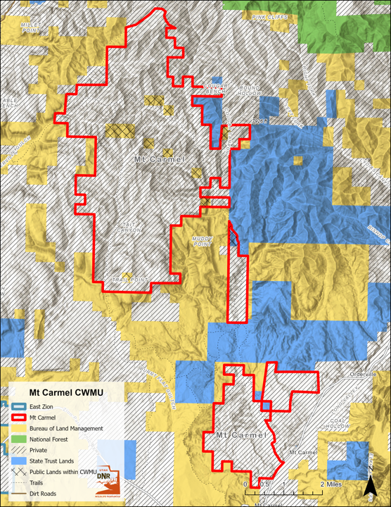
Mt Carmel
Public land has some accessible and some inaccessible
They have 460 public acres
They have 14,657 private acres
Public benefit – public draw gets access

Slide 9
2024 renewals – Not accessible and Trade lands
CWMU | Species | Private Acres | Public Acres | Trade lands
Indian Head | Deer, elk | 22,744 | 1,130 | 729
Roan Cliffs | Deer, elk | 10,045 | 480 | 680
Park Valley Hereford | Deer | 12,253 | 2,180 | 640

Slide 10
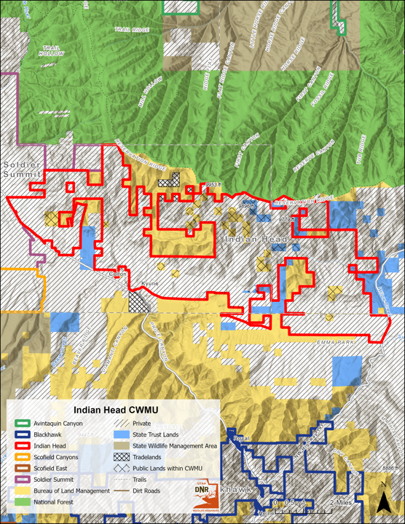
Indian Head
Public land is not accessible
They have 1,130 public acres and 729 acres of trade lands
They have 22,744 private acres
Public benefit – trade lands

Slide 11
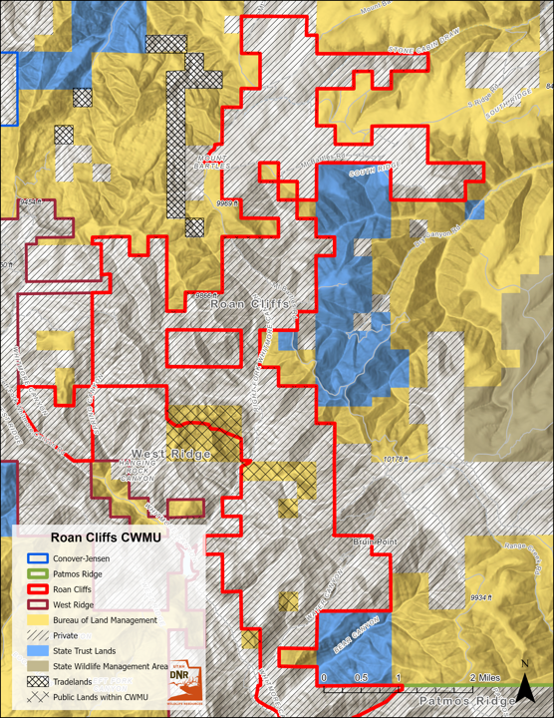
Roan Cliffs
Public land is not accessible
They have 480 public acres and 680 acres of trade lands
They have 10,045 private acres
Public benefit – trade lands

Slide 12
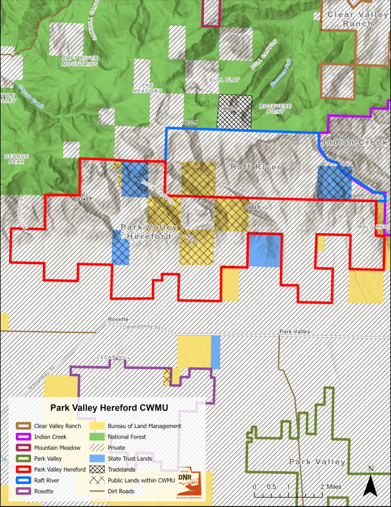
Park Valley Hereford
Public land is not accessible
They have 2,180 public acres and 640 acres of trade lands
They have 12,253 private acres
Public benefit – trade lands and tags are 30:10 or 6 extra tags (deer)

Slide 13
2024 renewals – Not accessible and border
CWMU | Species | Private Acres | Public Acres | Trade lands
Deseret | Deer, elk, pronghorn, moose | 225,228 | 15,359 | -
Alton | Deer, elk | 34,212 | 1,860 | -
Green Canyon | Deer | 5,790 | 90 | 120
North Peaks | Deer, elk | 26,244 | 2,040 | 2,029

Slide 14
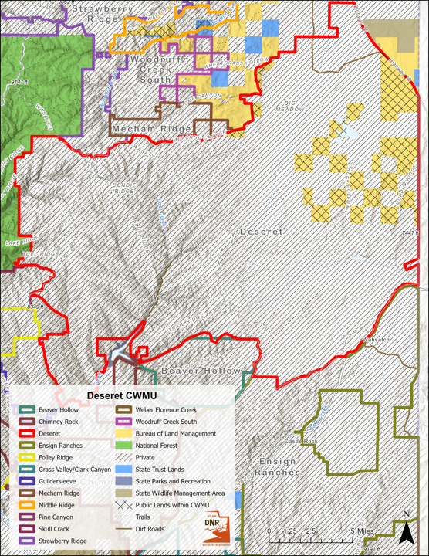
Deseret
Public land has some accessible and some inaccessible
They have 15,359 public acres
They have 225,228 private acres
Public benefit – trade lands and 6.4% extra tags

Slide 15
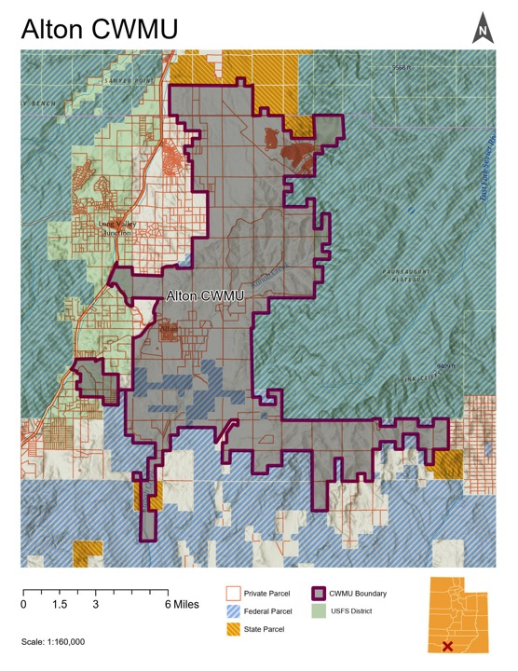
Alton
Public land has some accessible and some inaccessible
They have 1,860 public acres
They have 33,995 private acres
Public benefit – additional permit for deer and elk

Slide 16
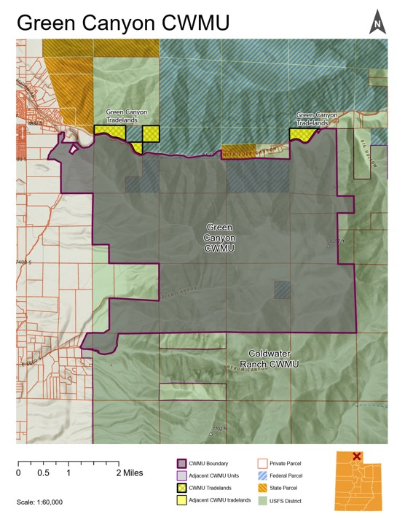
Green Canyon
Public land has some accessible and some inaccessible
They have 185 public acres and 120 acres of trade lands
They have 6,120 private acres
Public benefit – trade lands

Slide 17
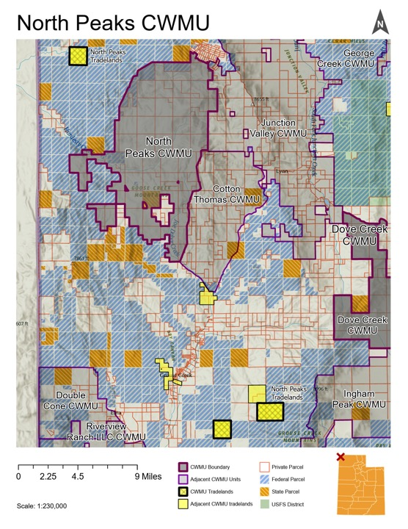
North Peaks
Public land has some accessible and some inaccessible
They have 1,566 public acres and 2,029 acres of trade lands
They have 27,464 private acres
Public benefit – trade lands

Slide 18
2024 renewals – border
CWMU | Species | Private Acres | Public Acres | Trade lands
Middle Ridge | Deer | 5,188 | 1,337 | -
Dove Creek | Deer | 18,770 | 570 | 3,040
South Canyon | Deer, elk, moose | 16,260 | 480 | -
Bar J | Deer, elk | 5,970 | 330 | 370

Slide 19
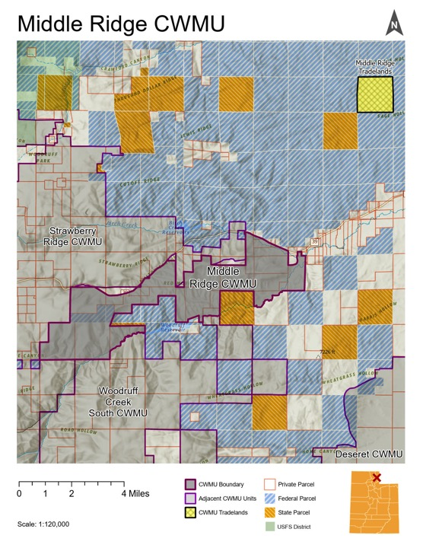
Middle Ridge
Public land is accessible
They have 260 public acres and 657 acres of trade lands
They have 5,838 private acres
Public benefit – extra deer permit (5:2)

Slide 20
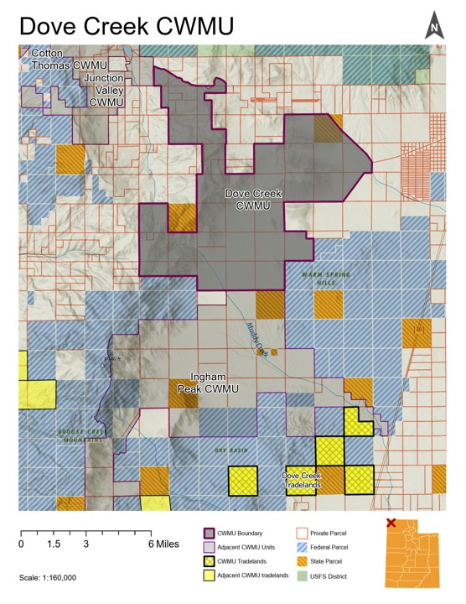
Dove Creek
Public land is accessible
They have 570 public acres and 3,040 acres of trade lands
They have 18,770 private acres
Public benefit – trade lands

Slide 21
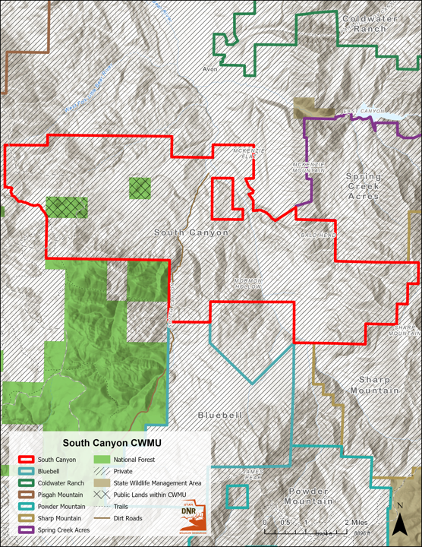
South Canyon
They have 480 public acres
They have 16,260 private acres
Public benefit – 2% extra tags

Slide 22
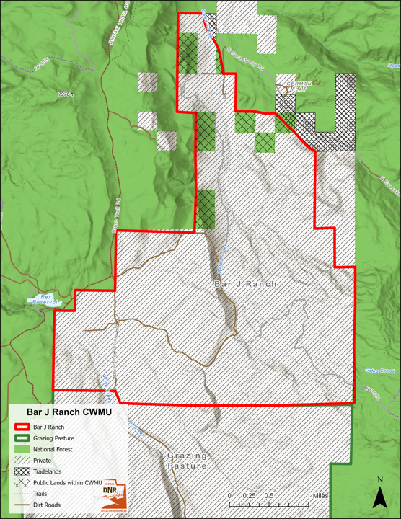
Bar J
Public land has some accessible and some inaccessible
They have 330 public acres and 370 acres of trade lands
They have 5,970 private acres
Public benefit – trade lands

Slide 23
2024 renewals – DWR management
CWMU | Species | Private Acres | Public Acres | Trade lands
Double Cone | Deer, elk | 5,329 | 4,365 | 4,058
Old Woman | Deer, elk | 6,840 | 1,280 | -

Slide 24
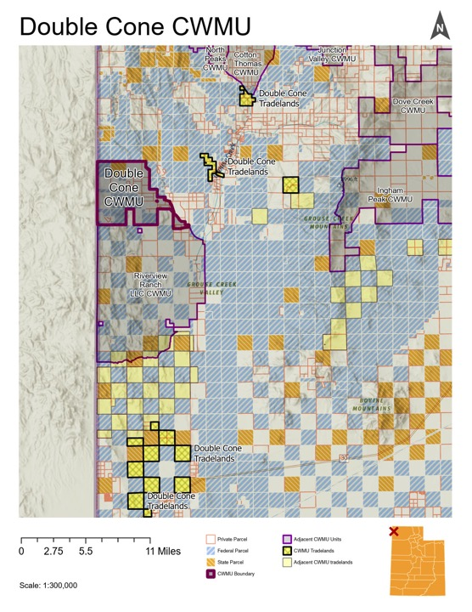
Double Cone
Public land is accessible
They have 4,365 public acres and 4,058 acres of trade lands
They have 5,329 private acres
Public benefit – trade lands and 3.2% extra permits

Slide 25
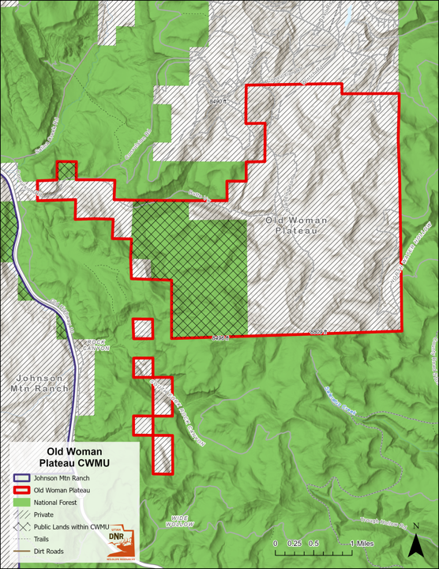
Old Woman Plateau
Public land is accessible
They have 1,400 public acres and 289 acres of trade land
They have 6,565 private acres
Public benefit – 2 deer tags and 1 elk tag
Public taken out would cause a non contiguous or smaller CWMU

Slide 26
Thank you

